Slide 1

Nashville Software School “Save the Tatas”
Presented by Adrianne Austin
Cohort da7 – Capstone

Slide 2
Inspiration for the project
My passion in helping others has led me to pursue a data analytics career within the healthcare industry.
Breast Cancer is in my family. We are fortunate that my cousin was able to have access to the medical treatment for her cancer, which now in now in remission.
My primary goal for my capstone project is to continue to bring awareness to the ongoing fight in lowering the breast cancer deaths amongst our female population.

Slide 3
Introduction: Breast Cancer Facts
According to the American Cancer Society(ACS):
For 2020 stats, ACS estimate about 287,850 women will be diagnosed with new cases of invasive breast cancer and approx. 43,250 women will die from breast cancer.
Chances of getting breast cancer
The average risk of a woman, developing breast cancer sometime in her life is about 13%.
Which means there is a 1 in 8 chance a female will develop breast cancer.
Currently, the best way to find breast cancer for most women is through a mammogram.
The ACS recommends women aged 40 to 44 should get mammogram screenings at least one a year and annual screenings for women aged 45 to 49.

Slide 4
Capstone Project
For this project, I want to examine the mortality rates of women in the state to see if there is a correlation between the high death rates, the number of available mammograph facilities and insurance.
For counties that have a higher death rate, how many mammograph facilities are available?
Correlation between number of facilities available per county and the mortality rate.
For the counties that have a higher death rate, how many of the females within those counties have insurance coverage?
Correlation between access to insurance coverage and the mortality rate.
My goal again of my capstone project is to highlight the importance of combating breast cancer deaths amongst our female population.

Slide 5



Dataset & Analysis Tools
Death Rates by County - State Cancer Profile
The stats are produced are from a collaboration between the National Cancer Institute and Centers for Disease Control and Prevention.
Death rates by County during 2016-2020 timeframe.
https://statecancerprofiles.cancer.gov/
Insurance Coverage & Income
US Census Bureau – American Community Survey 5-Year Estimate 2016 – 2020
https://data.census.gov/
FDA Mammograph Facilities
https://www.accessdata.fda.gov/
Python
Excel

Slide 6
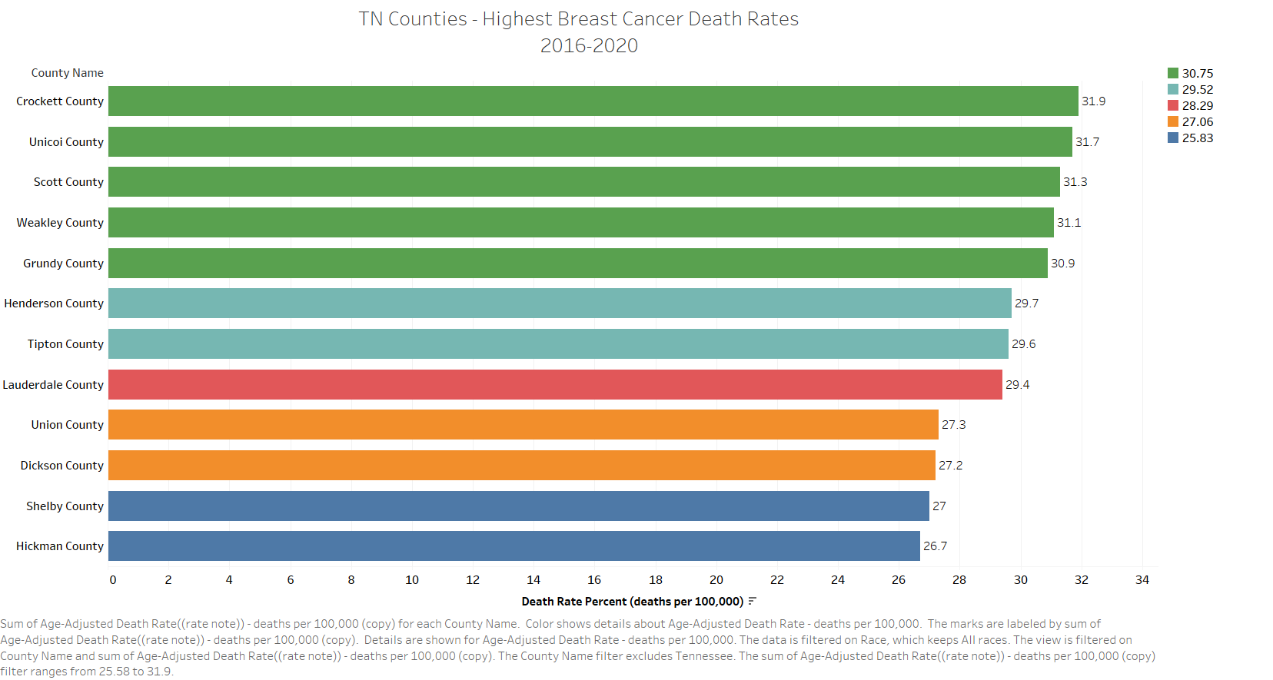

Slide 7
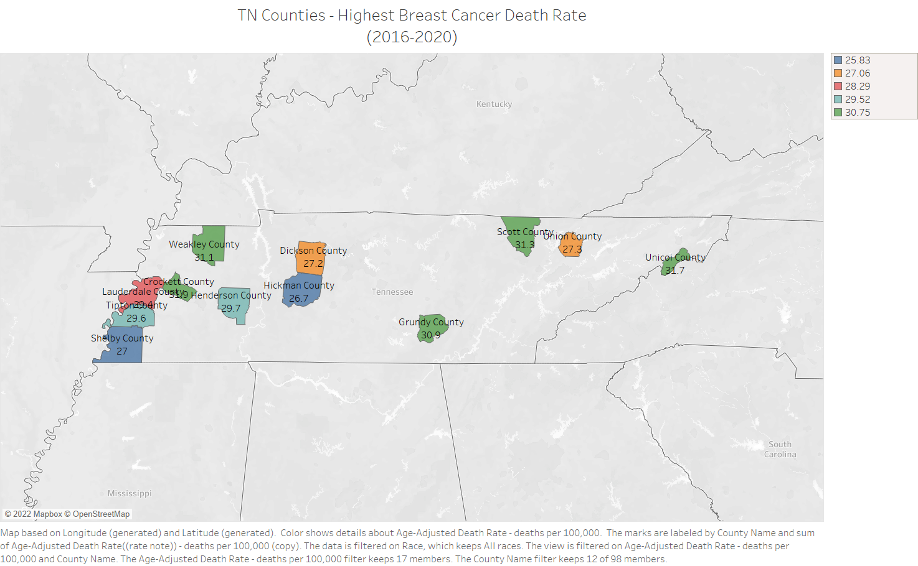

Slide 8
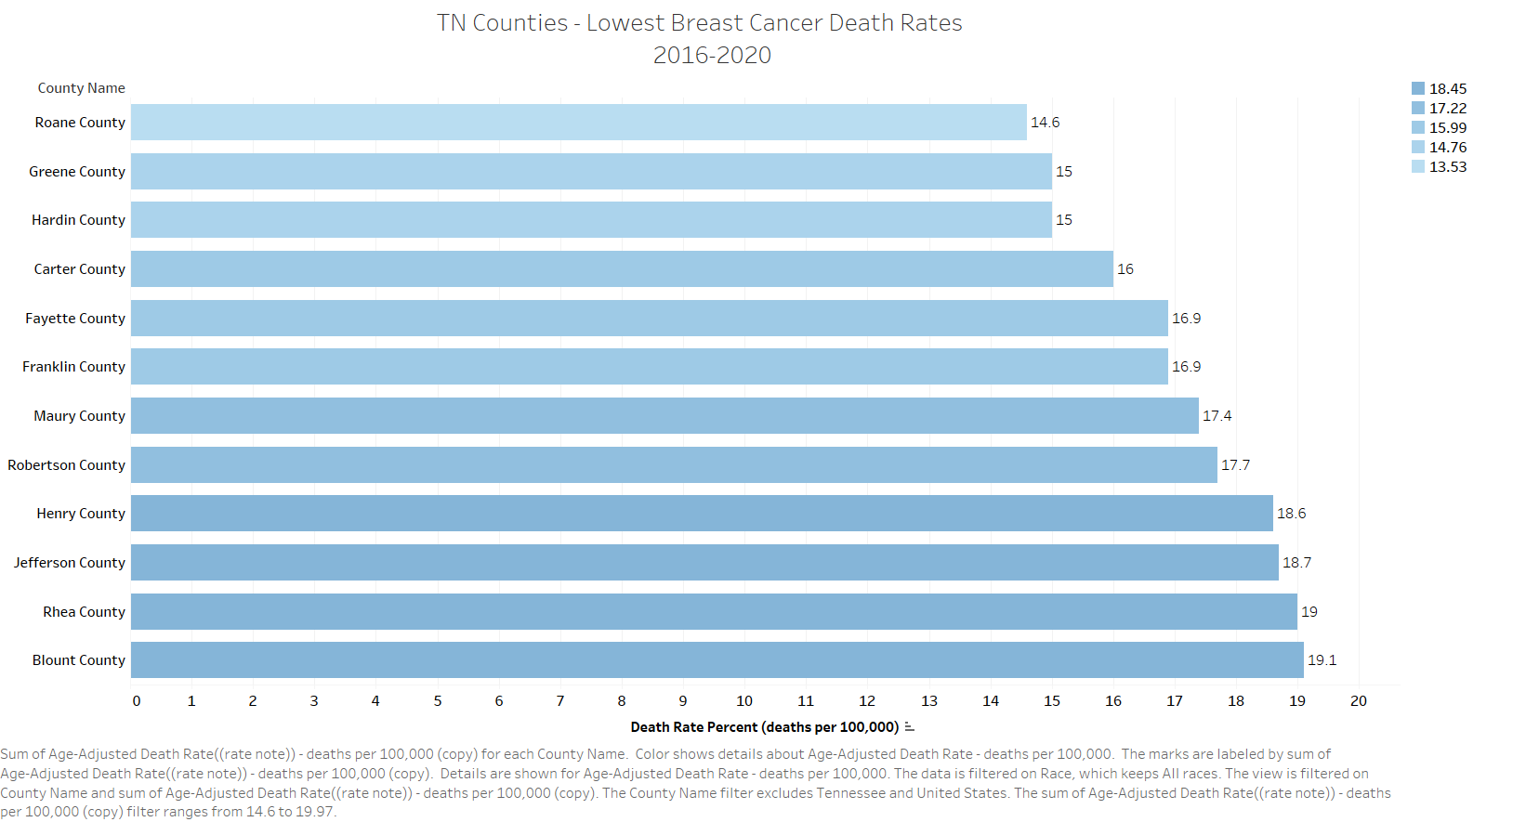

Slide 9
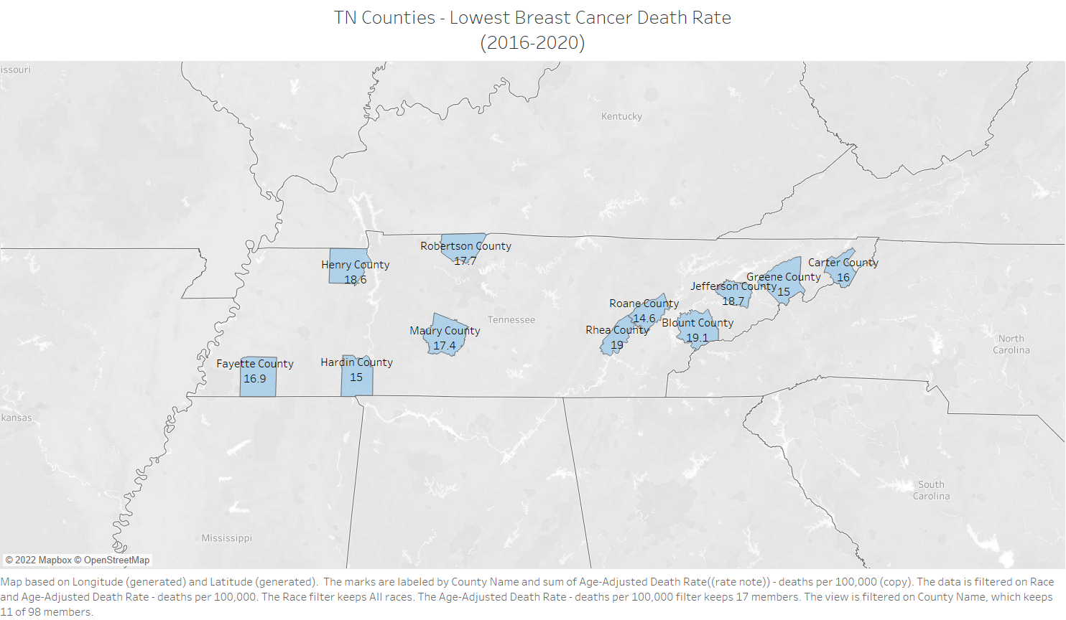

Slide 10
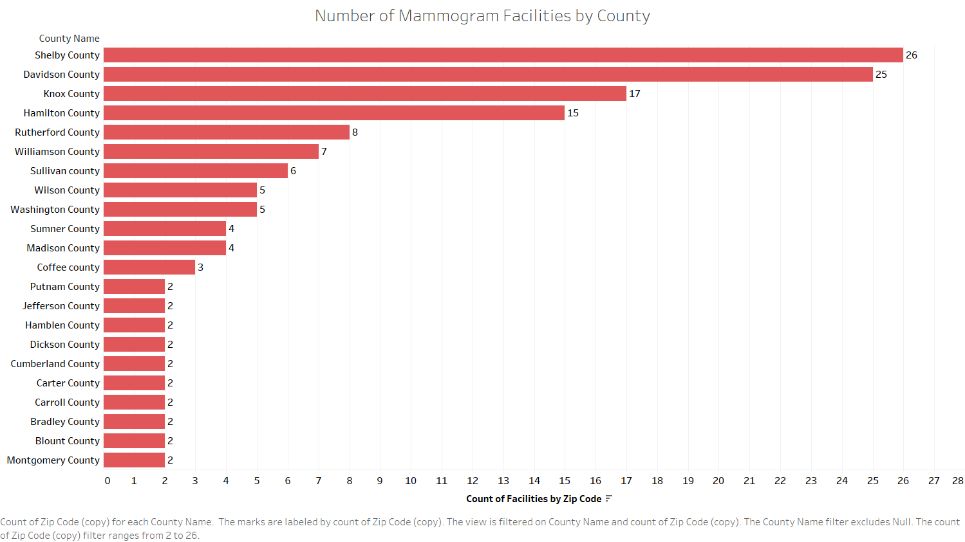
Notes:
There are 192 FDA approved mammogram facilities located in TN within 69 counties.

Slide 11
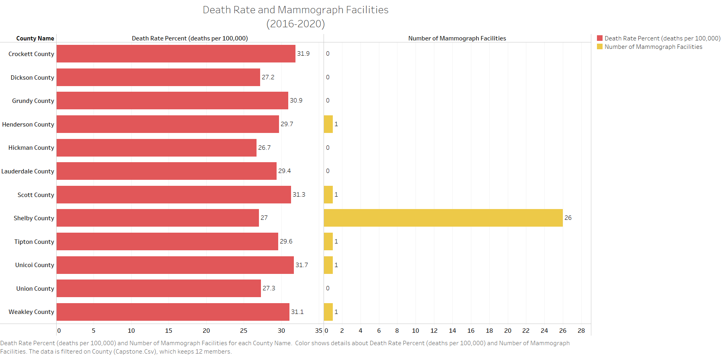

Slide 12
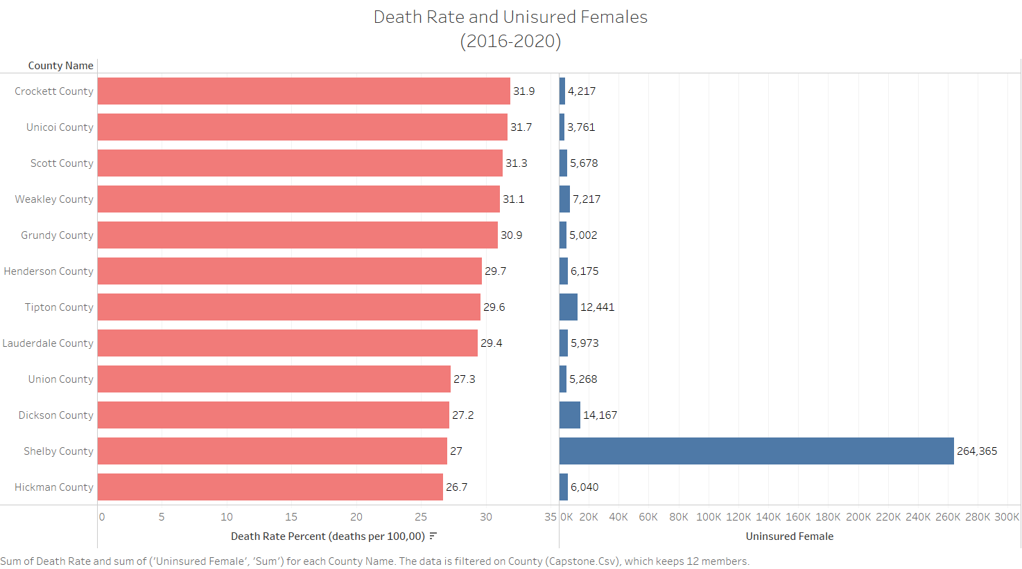

Slide 13
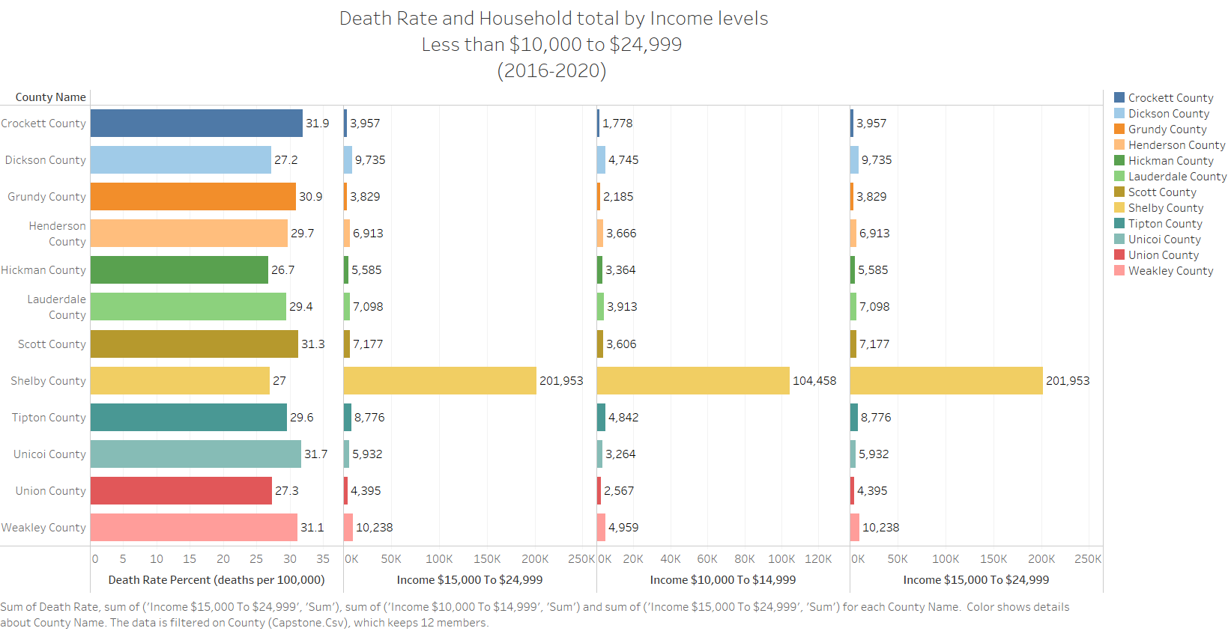

Slide 14
Analysis and Conclusion
First Question: Is there a correlation between the counties that have a higher death rate with the number of available mammograph facilities? If so, what is the correlation?
Yes, the counties that have a higher death rate have 1 or fewer than 2 mammograph facilities, except for Shelby County.
Second Question: Is there another factor, such as insurance that also plays a factor in higher mortality rates within these counties?
Yes. According the Census Bureau – between 2016-2020 about 4,052,700 people were uninsured or didn’t have insurance coverage within Shelby County and out of that number about 264,365 were uninsured females.

Slide 15
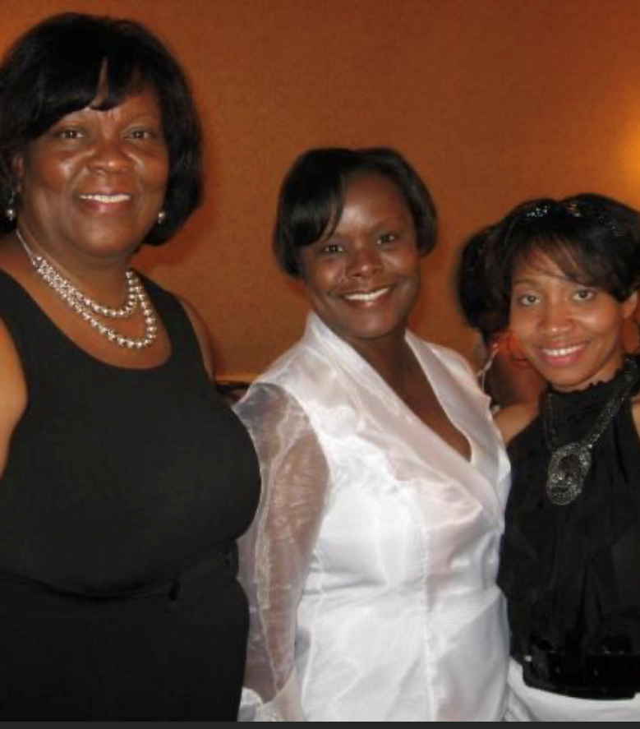


My 2nd Cousin - Deborah

